Slide 1


Improving Prediction Confidence in Healthcare: A Machine Learning Approach
Identifying and Addressing Uncertainty in Medical Predictions
Under the supervision of
Olivier Lefebvre
PhD student in Computer Science
Université de Sherbrooke
Martin Vallières, Professor of Computer Science, Université de Sherbrooke
Félix Camirand Lemyre, Professor of Mathematics, Université de Sherbrooke
Dan Poenaru, Professor of Pediatric Surgery, McGill University

Slide 2

AI for healthcare
Great potentials for healthcare
    Support clinicians
    Enable early detection of diseases
Empowering personalization: Great impact on patients
    Support precision medicine by leveraging vast data sources
Multiple challenges
    Fairness: Biases across patient groups
    Transparency / Interpretability

Slide 3

Good metrics => Good model for everyone?
Global metrics, Local variability
    Model can perform well globally, but fail for specific subgroups of patient
Performance gaps between patients
    Some groups might face higher error rates
Curse of dimensionality on precision medicine
    High-dimensional data => harder to learn
    Patients with rare profiles especially at risk of poor performance

Slide 4



Quick illustration
Sick
Healthy
Train set
Classification metrics
More
 | Train set (Montréal) | Test set (Sherbrooke)
Accuracy | 82.1% | 80.3%
Activity level
Healthy
Sick
Less
18
70
Age

Slide 5


Quick illustration
Sick
Healthy
Train set
Test set
More
More
Healthy
Activity level
Activity level
Healthy
Sick
Sick
Less
Less
18
0
18
70
70
Age
Age

Slide 6
Quick illustration
Sick
Healthy
Classification metrics
Test set
 | Train set (Montréal) | Test set (Sherbrooke)
Accuracy | 82.1% | 80.3%
More
Healthy
Activity level
Metrics by profile
Sick
 | <18 yo | >=18yo
Accuracy | 53.3% | 90%
Less
0
18
70
Age

Slide 7














Concept of profiles
Profiles
Profile 1: Women
Profile 2: Men
Profile 3: Men, -50 yo
Profile 4: Men, +50 yo
Population
Women
Men
+50 y/o
-50 y/o

Slide 8
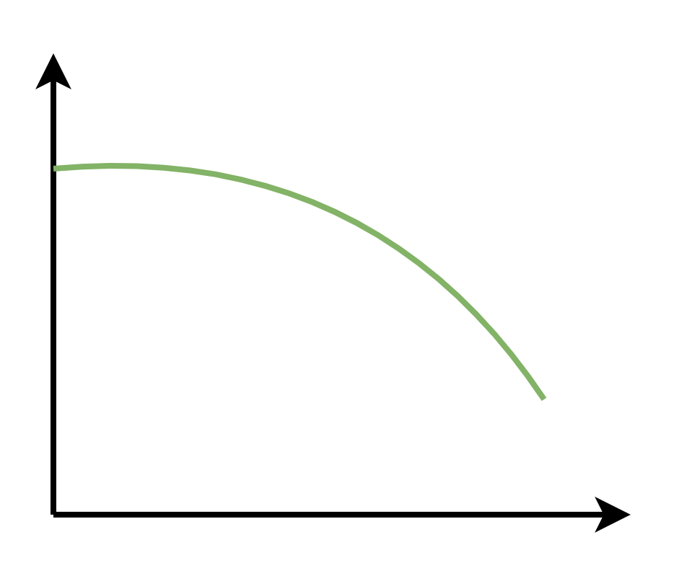
Importance of investigating performance per patient / profiles
Prevent errors & Reduce bias
Monitor temporal changes
    (Societal/Institutional changes, Pandemic, …)
Adapt to model shifts
Model Quality
Time

Slide 9
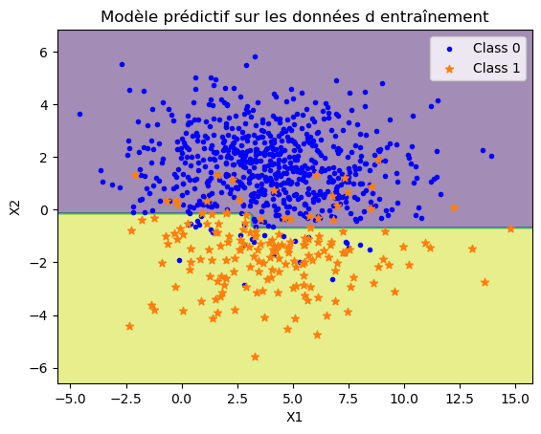
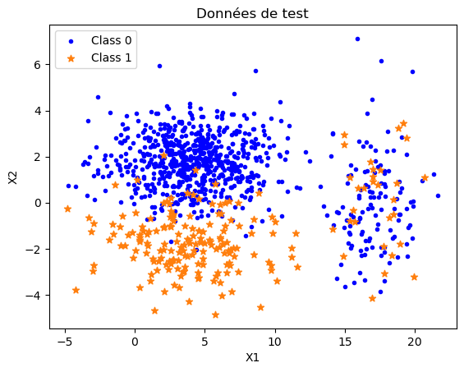
Predictive Performance Precision Analysis: 3PA
We have a BaseModel for binary classification, well trained and calibrated on a Training dataset, Which we want to apply on a Testing dataset
BaseModel
(On training data)
Testing Data
X2
X2
Class 0
Class 1
X1
X1

Slide 10
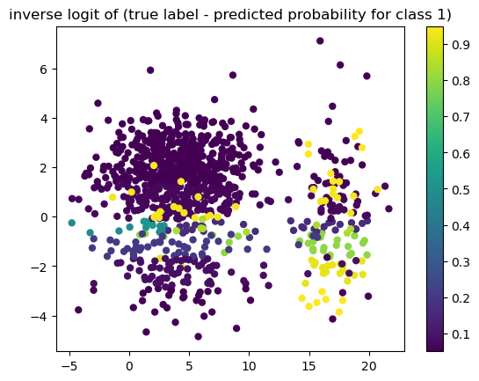
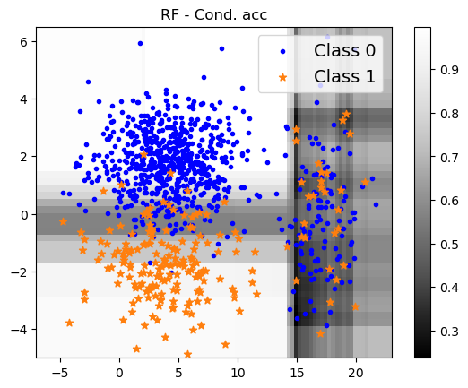
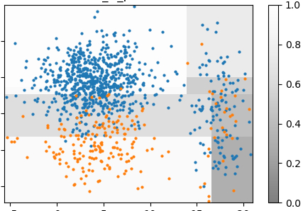
3pa Method characteristics
Uncertainty level
Confidence prediction
Profiles
X2
X2
X2
Uncertainty
Confidence
Confidence
X1
X1
X1
| Predicted probability – Real target |

Slide 11
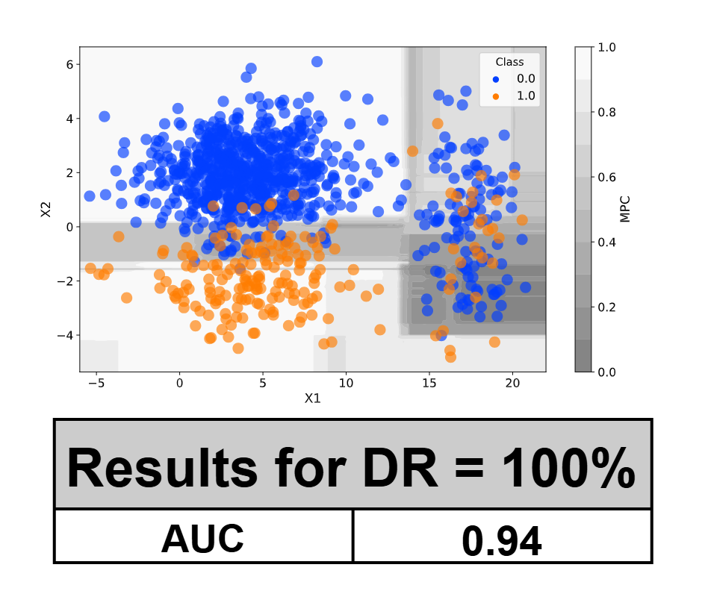
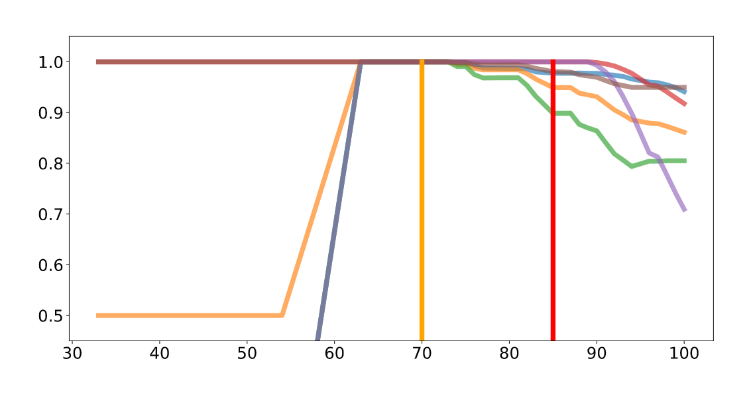
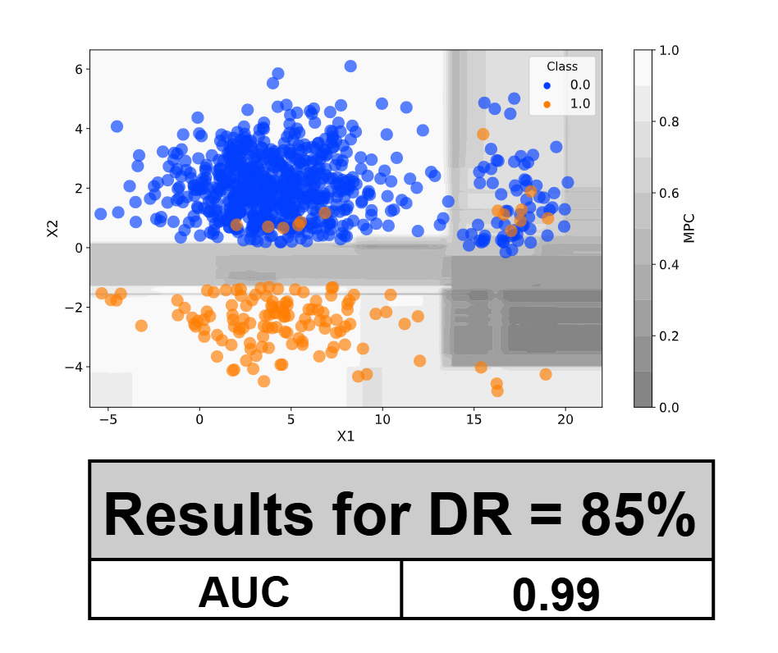
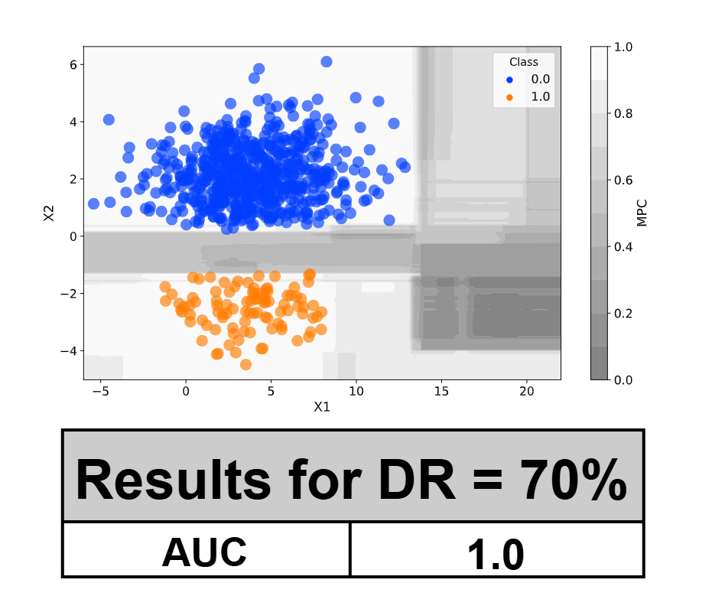
3pa Method Evaluation
Metrics by Declaration Rate (MDR)
Specificity
Metrics values
Sensitivity
AUROC
Declaration Rate (DR%)

Slide 12
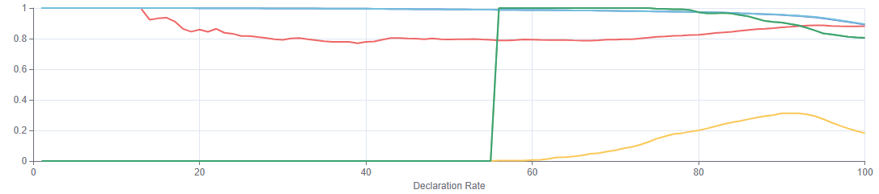
Results: One Year mortality - CHUS
BaseModel (Random Forest)
Trained: 07-2011 to 06-2017
Tested: 07-2017 to 06-2021
100
80
Choice of Declaration Rate
60
Metric values
DR = 92%
Accuracy | Recall | AUC | NPV | PPV
+.05 | +.13 | +0 | +.06 | +.08
40
20
0
Metrics in profiles
 | Profile with best performance | Profile with worst performance
Description | - Age <= 58 - No brain cancer diagnosed at admission - Not admitted to Hematology / Oncology | - Age <= 58 - Brain cancer diagnosed at admission - One or less previous visits to Emergency Department
Accuracy | 0.973 | 0.383
AUROC | 0.919 | 0.675
40
60
80
100
Declaration Rate (%)

Slide 13



Next steps
Re-train the BaseModel:
    Update the model to better include previously targeted patients

Slide 14




Intended uses
Want to deploy in Sherbrooke
Good global metrics in Sherbrooke
BaseModel
Trained in Montréal
Sherbrooke
Montréal
Performance
Deploy BaseModel in Sherbrooke??

Slide 15
Intended uses
Want to deploy in Sherbrooke
Good global metrics in Sherbrooke
BaseModel
Trained in Montréal
Sherbrooke
Investigate uncertainty
Montréal
Performance
Use BaseModel when enough confident

Slide 16
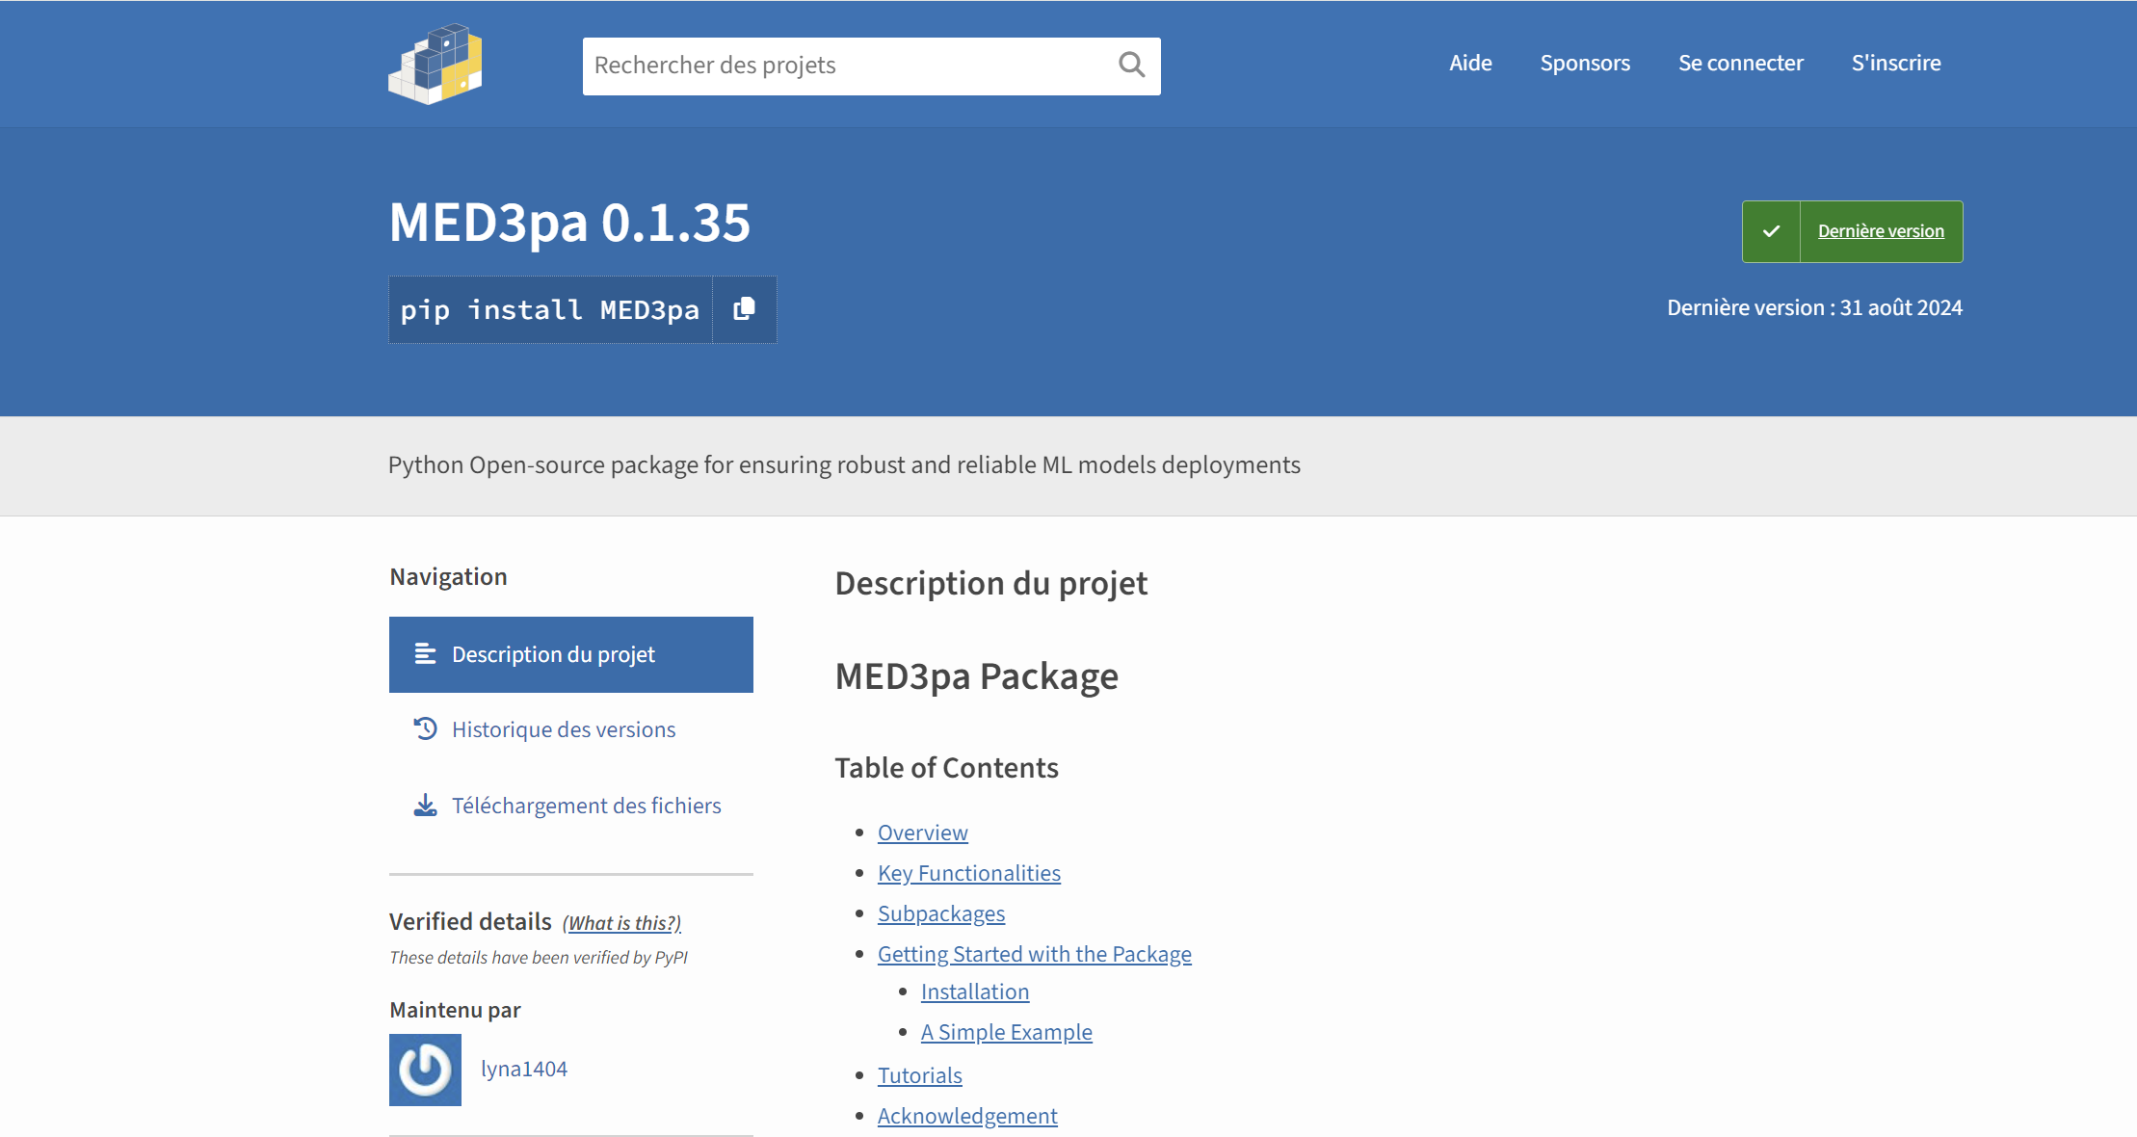
Conclusion
Development of the 3PA method
    Novel method to predict uncertainty and identify uncertainty profiles
Preliminary results
    On CHUS dataset for One-Year-Mortality & other public datasets
    Manuscript currently under preparation
Open-Source contribution
    Open-source package for 3PA:
    https://github.com/MEDomics-UdeS/med3pa

Slide 17







Questions?
Open-source package available :
https://github.com/MEDomics-UdeS/med3pa
Acknowledgements
Martin Vallières
Supervisor
UDS
Félix Camirand Lemyre
Co-Supervisor
UDS
Dan Poenaru
Co-Supervisor
McGill
Jean-François Ethier
Former Co-Director
UDS
Lyna Hiba Chikouche
Intern
ESI
Ludmila Amriou
Intern
ESI

