Slide 1

Synthetic Data for Accessible Learning in Healthcare: Improving Mortality Prediction with Longitudinal Data
Hakima Laribi PhD student, Department of Computer Science, Université de Sherbrooke
Nicolas Raymond M.Sc., BMath, Department of Computer Science, Université de Sherbrooke
Ryeyan Taseen MD, M.Sc., Department of Medicine, Cambridge Memorial Hospital
Dan Poenaru Professor, Department of Pediatric Surgery, McGill University
Martin Vallières Professor, Department of Computer Science, Université de Sherbrooke
medomics-udes.org

Slide 2
“Predicting the life expectancy of individual patients can be important for both medical decision-making and research”
[Carl van Walraven et al., 2015]

Slide 3
Among a sample of approximately 1/3 of Canadians:
56%
26%
75%
Died in-hospital
Experienced ICU admission in their last visit
Seen > 10 doctors in the last 6 months
Source:Fowler, R., & Hill, A. (2018). A National Comparison of Intensity of End-Of-Life Care in Canada: Defining Changing Patterns, Risk Factors and Targets for Intervention. Canadian Frailty Network.

Slide 4
However, when surveying families of patients who died in-hospital:
(1) It is important to initiate goals-of-care discussions with end-of-life patients
72%
Prefer out-of-hospital death
“Some” patients receive care that doesn't match their preferences.
Source:Fowler, R., & Hill, A. (2018). A National Comparison of Intensity of End-Of-Life Care in Canada: Defining Changing Patterns, Risk Factors and Targets for Intervention. Canadian Frailty Network.

Slide 5


Goals Of Care (GOC) discussions:
Does the patient want to be reanimated?
Does the patient want to be intubated?
Does the patient prefer to start palliative care?
Does the patient want to proceed with potentially aggressive care?

Slide 6
However, when surveying families of patients who died in-hospital:
(1) It is important to initiate goals-of-care discussions with end-of-life patients
(2) We need to identify patients at high risk of mortality early
72%
Prefer out-of-hospital death
“Some” patients receive care that doesn't match their preferences.
Source:Fowler, R., & Hill, A. (2018). A National Comparison of Intensity of End-Of-Life Care in Canada: Defining Changing Patterns, Risk Factors and Targets for Intervention. Canadian Frailty Network.

Slide 7
Automated identification of patients AT high risk of One-year mortality
Hospital One-year Mortality Risk (HOMR) score
Using administrative data collected in patients’ electronic health records (EHRs) :
One-year mortality prediction post-discharge
One-year mortality prediction during admission
One-year mortality prediction during and/or at admission
HOMR
HOMR Now!
mHOMR
RF-HOMR
[Walraven, 2014]
[Walraven et al., 2017]
[Wegier et al., 2019]
[Taseen et al., 2021]

Slide 8





Challenges:
Some patients have multiple visits.
Visit 1
Visit 2
Visit 3
Visit 4
Previous studies considered patients’ visits independently
A patient’s longitudinal history could impact prognostication.

Slide 9
Challenges:
Some patients have multiple visits.
A patient’s longitudinal history could impact prognostication.
Visit 1
Visit 2
Visit 3
Visit 4
Temporal aggregation
Simulate a clinician's holistic consideration of a patient's history before making medical prognoses, diagnoses, or decisions.

Slide 10
Testing in a real-world scenario, when a patient is admitted multiple times:
Prediction
Prediction
Prediction
Visit 1
Visit 2
Visit 1
Visit 2
Visit 3
Visit 1
Visit 2
Visit 3
Visit 4

Slide 11
To improve end-of-life care, we need to
Identify patients at high risk of one-year mortality at admission.
Integrate information from patients’ previous visits.

Slide 12
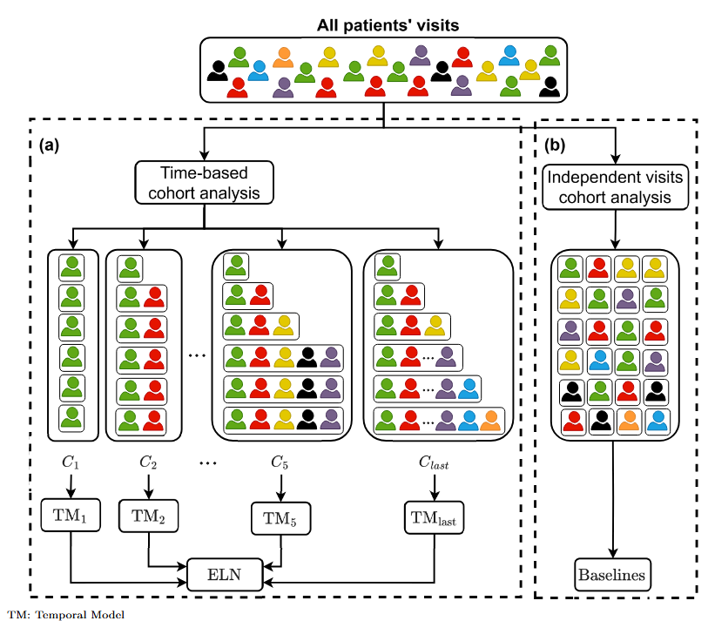
Methods
Train temporal models on a single patient visit while incorporating longitudinal data.
The Ensemble Longitudinal Network (ELN) combines predictions from all temporal models.
Baseline models consider each patient’s visits independently.
Long Short-Term Memory neural network (LSTM)
TM: Temporal Model
Learn different longitudinal patterns!!

Slide 13


DATASET
Private dataset
Publicly available
Original dataset
CIUSSS de l’Estrie-CHUS, Sherbrooke, Canada
123,646 patients
250,812 hospitalizations (July 1st, 2011 – June 30th, 2021)
~ 15% of patients that experienced one-year mortality
Synthetic dataset
123,646 patients
248,485 hospitalizations
In partnership with Octopize.io
Map each patient to a synthetic patient using the AVATAR method (Guillaudeux et al., 2023)
Including 244 predictors:
Demographics | Admission characteristics | Admission diagnoses | Comorbidity diagnoses
AdmDemo predictors
AdmDemoDx predictors (more difficult to acquire)

Slide 14
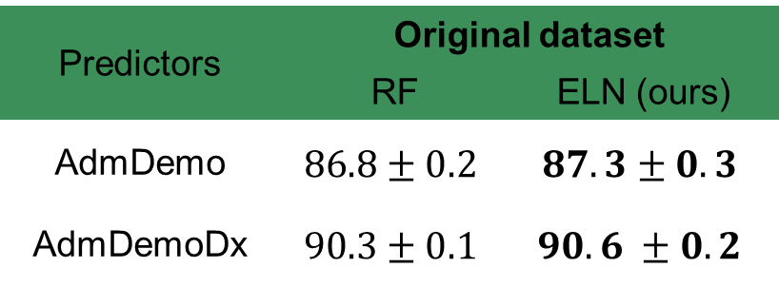
Results -- Prediction of one-year mortality
AdmDemo predictors: minimal data access requirements + acceptable performance.
AUROC comparisons
Predictors | Original dataset
 | RF | ELN (ours)
AdmDemo | $$86.8±0.2$$ | $$87.3±0.3$$
AdmDemoDx | $$90.3±0.1$$ | $$90.6 ±0.2$$
RF: Random Forest, a previously developed model (Taseen et al., 2021).
AUROC comparisons: Incorporating patients’ longitudinal data improves the HOMR score.

Slide 15
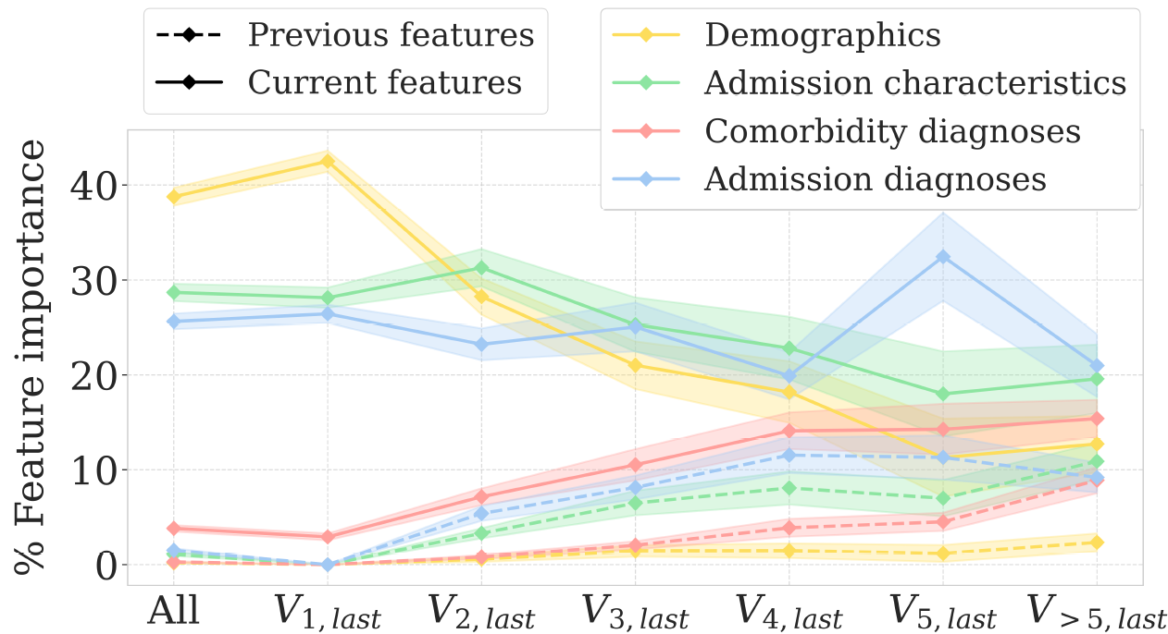
Results -- Prediction of one-year mortality
Feature importance analyses
Patients
1 visit
2 visits
3 visits
4 visits
5 visits
> 5 visits
Incorporating longitudinal history is particularly beneficial for patients with several hospital visits.

Slide 16
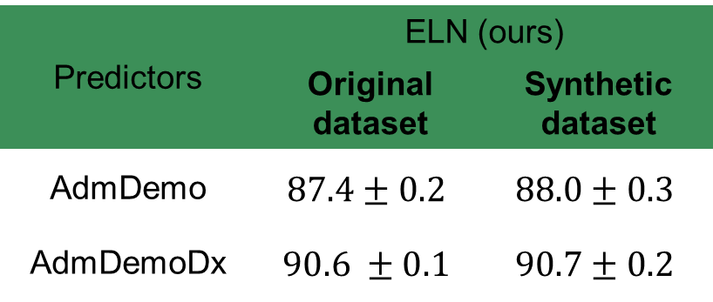
Results -- Prediction of one-year mortality
The synthetic dataset performed similarly to the original dataset, with comparable improvements when using the ELN.
AUROC comparisons – Original dataset vs Synthetic dataset
Predictors | ELN (ours)
 | Original dataset | Synthetic dataset
AdmDemo | $$87.4±0.2$$ | $$88.0±0.3$$
AdmDemoDx | $$90.6 ±0.1$$ | $$90.7±0.2$$

Slide 17
Key points from this talk:
Integrating patients' previous visits improves the prediction of their one-year mortality risk.
We can estimate one-year mortality risk using only demographics and admission characteristics, without adding diagnoses.
We generated a synthetic dataset with characteristics similar to the original private dataset and shared it publicly to encourage further research.

Slide 18



Questions?
Learn more:
doi.org/10.5281/zenodo.12954672
doi.org/10.1101/2024.06.21.24309191
github.com/MEDomics-UdeS/POYM
Public synthetic dataset
medrXiv preprint
Code

